Slide 1
CHAPTER 4
ASSOCIATIVE MEMORY NETWORKS
“Principles of Soft Computing, 2nd Edition”
by S.N. Sivanandam & SN Deepa
Copyright © 2011 Wiley India Pvt. Ltd. All rights reserved.

Slide 2
PATTERN ASSOCIATION
Associating patterns which are
  similar,
  contrary,
  in close proximity (spatial),
  in close succession (temporal).
Associative recall
  evoke associated patterns,
  recall a pattern by part of it,
  evoke/recall with incomplete/noisy patterns.
“Principles of Soft Computing, 2nd Edition”
by S.N. Sivanandam & SN Deepa
Copyright © 2011 Wiley India Pvt. Ltd. All rights reserved.

Slide 3
ASSOCIATIVE MEMORY (AM) NETWORK
Two types of associations exist. For two patterns s and t
  hetero-association (s != t): relating two different patterns (s – input, t – target).
  auto-association (s = t): relating parts of a pattern with other parts.
Architectures of NN associative memory:
  single layer (with/out input layer),
  two layers (for bidirectional association)
Learning algorithms for AM:
  Hebbian learning rule and its variations,
  gradient descent.
“Principles of Soft Computing, 2nd Edition”
by S.N. Sivanandam & SN Deepa
Copyright © 2011 Wiley India Pvt. Ltd. All rights reserved.

Slide 4
ASSOCIATIVE MEMORY NETWORK
WORKING PROCESS
  Recall a stored pattern by a noisy input pattern.
  Using the weights that capture the association.
  Stored patterns are viewed as “attractors”, each has its “attraction basin”.
  Often call this type of NN “associative memory” (recall by association, not explicit indexing/addressing).
“Principles of Soft Computing, 2nd Edition”
by S.N. Sivanandam & SN Deepa
Copyright © 2011 Wiley India Pvt. Ltd. All rights reserved.

Slide 5
TRAINING ALGORITHM FOR ASSOCIATIVE MEMORY NETWORK
Network structure: single layer
  one output layer of non-linear units and one input layer.
s_1
x_1
w_11
y_1
t_1
w_1m
w_n1
s_n
x_n
w_nm
y_m
t_m
Goal of learning:
  to obtain a set of weights w_ij from a set of training pattern pairs {s:t} such that when s is applied to the input layer, t is computed at the output layer,
  for all training pairs s:t, tj = f(sTwj) for all j.
“Principles of Soft Computing, 2nd Edition”
by S.N. Sivanandam & SN Deepa
Copyright © 2011 Wiley India Pvt. Ltd. All rights reserved.

Slide 6


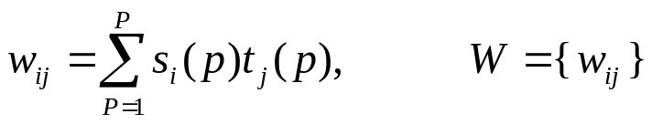
HEBB RULE FOR PATTERN ASSOCIATION
Algorithm (bipolar or binary patterns):
  For each training samples s:t:
  are ON (binary) or have the same sign (bipolar).
  Instead of obtaining W by iterative updates, it can be computed from the training set by calculating the outer product of s and t.
“Principles of Soft Computing, 2nd Edition”
by S.N. Sivanandam & SN Deepa
Copyright © 2011 Wiley India Pvt. Ltd. All rights reserved.

Slide 7
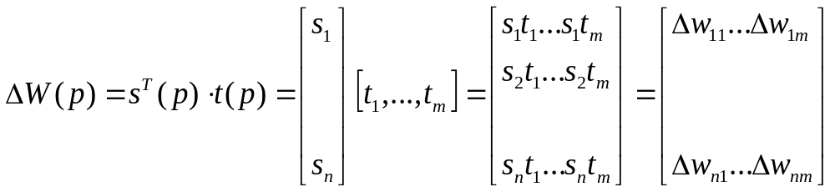
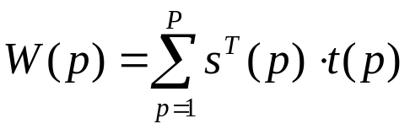
OUTER PRODUCT FOR PATTERN ASSOCIATION
Let s and t be row vectors.
Then for a particular training pair s:t
and
“Principles of Soft Computing, 2nd Edition”
by S.N. Sivanandam & SN Deepa
Copyright © 2011 Wiley India Pvt. Ltd. All rights reserved.

Slide 8
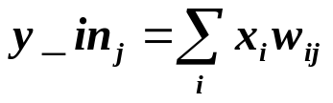
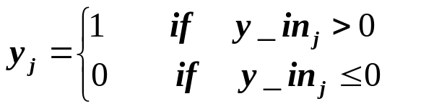
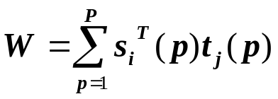
HETERO-ASSOCIATIVE MEMORY NETWORK
Binary pattern pairs s:t with |s| = 4 and |t| = 2.
Total weighted input to output units:
Activation function: threshold
Weights are computed by Hebbian rule (sum of outer products of all training pairs)
Training samples:
    s(p) t(p)
    p=1 (1 0 0 0) (1, 0)
    p=2 (1 1 0 0) (1, 0)
    p=3 (0 0 0 1) (0, 1)
    p=4 (0 0 1 1) (0, 1)
“Principles of Soft Computing, 2nd Edition”
by S.N. Sivanandam & SN Deepa
Copyright © 2011 Wiley India Pvt. Ltd. All rights reserved.

Slide 9
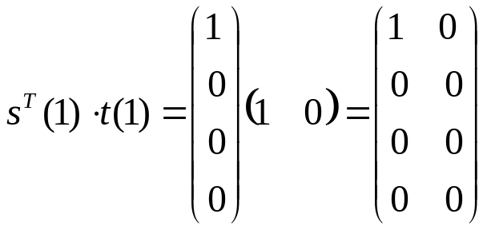
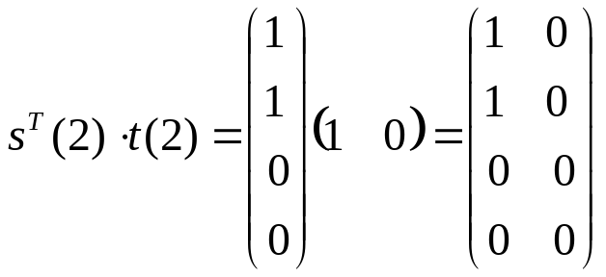
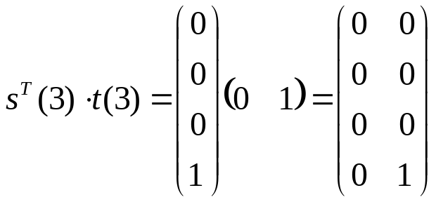
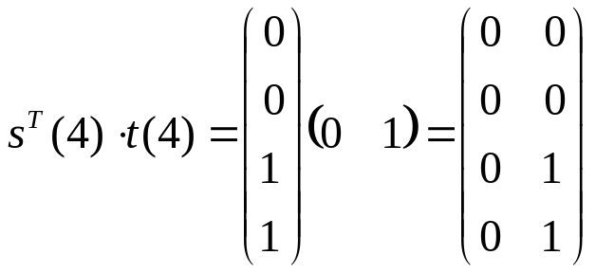
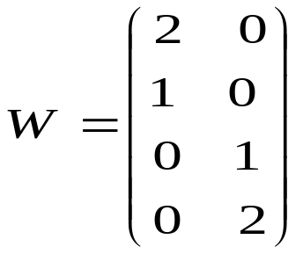
COMPUTING THE WEIGHTS
“Principles of Soft Computing, 2nd Edition”
by S.N. Sivanandam & SN Deepa
Copyright © 2011 Wiley India Pvt. Ltd. All rights reserved.

Slide 10
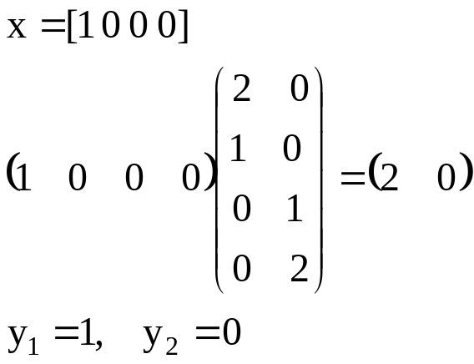
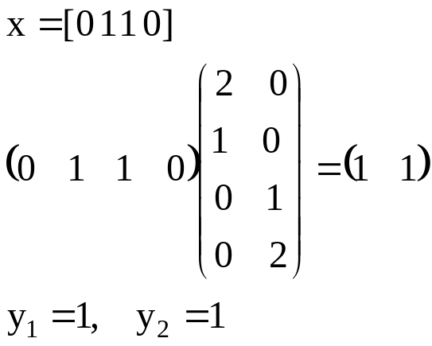
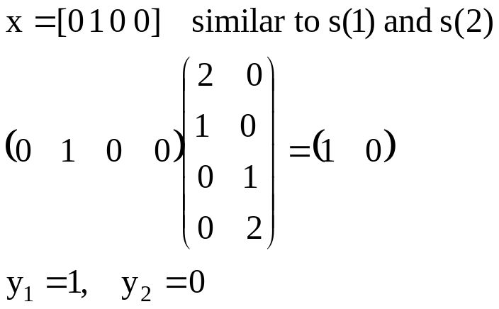
TEST/ RECALL THE NETWORK
(1 0 0 0), (1 1 0 0) class (1, 0)
(0 0 0 1), (0 0 1 1) class (0, 1)
(0 1 1 0) is not sufficiently similar to any class
“Principles of Soft Computing, 2nd Edition”
by S.N. Sivanandam & SN Deepa
Copyright © 2011 Wiley India Pvt. Ltd. All rights reserved.

Slide 11
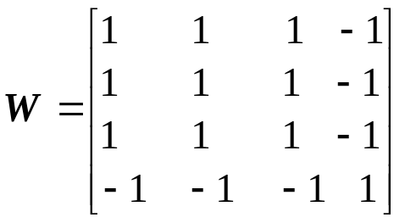
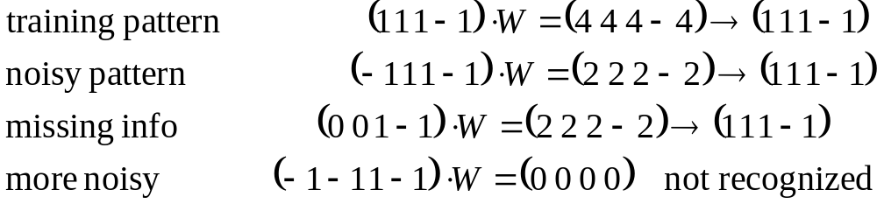
AUTO-ASSOCIATIVE MEMORY NETWORK
Same as hetero-associative nets, except t(p) =s (p).
Used to recall a pattern by a its noisy or incomplete version. (pattern completion/pattern recovery)
A single pattern s = (1, 1, 1, -1) is stored (weights computed by Hebbian rule or outer product rule.
“Principles of Soft Computing, 2nd Edition”
by S.N. Sivanandam & SN Deepa
Copyright © 2011 Wiley India Pvt. Ltd. All rights reserved.

Slide 12
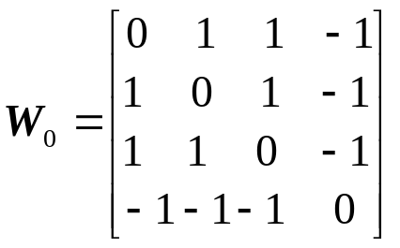
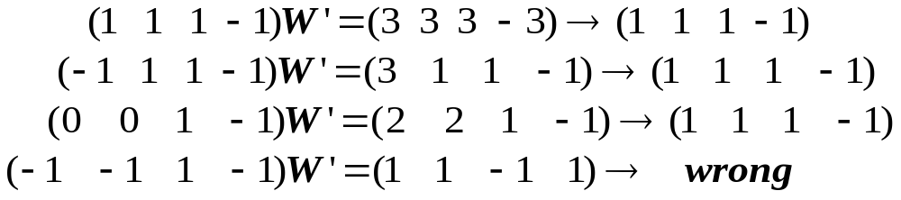
AUTO-ASSOCIATIVE MEMORY NETWORK – DIAGONAL ELEMENTS
Diagonal elements will dominate the computation when multiple patterns are stored (= P).
When P is large, W is close to an identity matrix. This causes output = input, which may not be any stoned pattern. The pattern correction power is lost.
Replace diagonal elements by zero.
“Principles of Soft Computing, 2nd Edition”
by S.N. Sivanandam & SN Deepa
Copyright © 2011 Wiley India Pvt. Ltd. All rights reserved.

Slide 13
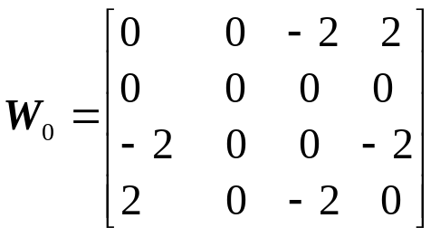
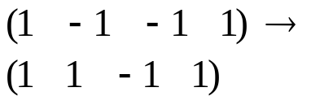
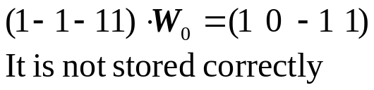
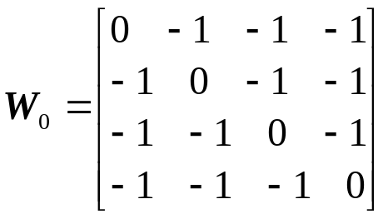
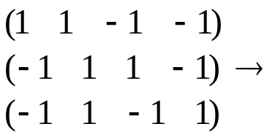
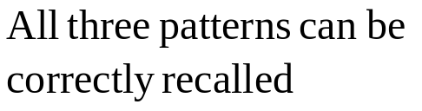
STORAGE CAPACITY
Number of patterns that can be correctly stored & recalled by a network.
More patterns can be stored if they are not similar to each other (e.g., orthogonal).
Non-orthogonal
Orthogonal
“Principles of Soft Computing, 2nd Edition”
by S.N. Sivanandam & SN Deepa
Copyright © 2011 Wiley India Pvt. Ltd. All rights reserved.

Slide 14
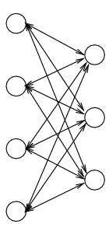
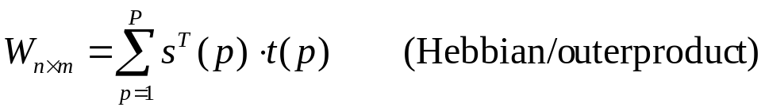

BIDIRECTIONAL ASSOCIATIVE MEMORY (BAM) NETWORK
Architecture:
  Two layers of non-linear units: X-layer, Y-layer.
  Units: discrete threshold, continuing sigmoid (can be either binary or bipolar).
Weights:
  Symmetric:
  Convert binary patterns to bipolar when constructing W.
“Principles of Soft Computing, 2nd Edition”
by S.N. Sivanandam & SN Deepa
Copyright © 2011 Wiley India Pvt. Ltd. All rights reserved.

Slide 15
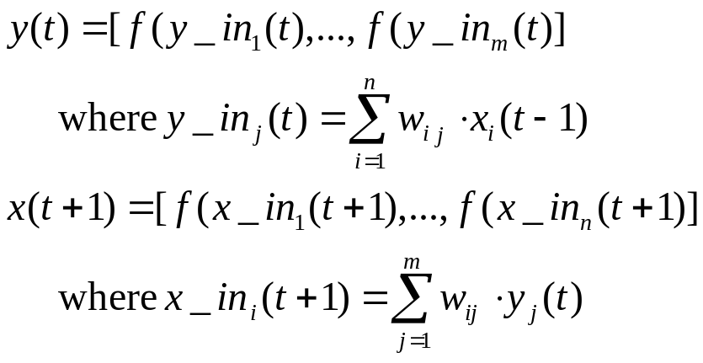
RECALL OF BAM NETWORK
  Bidirectional, either by X (to recall Y) or by Y (to recall X).
  Recurrent:
  Update can be either asynchronous (as in hetero-associative memory) or synchronous (change all Y units at one time, then all X units the next time).
“Principles of Soft Computing, 2nd Edition”
by S.N. Sivanandam & SN Deepa
Copyright © 2011 Wiley India Pvt. Ltd. All rights reserved.

Slide 16




ACTIVATION FUNCTIONS IN BAM
The activation function is based on whether the input target vector pairs used are binary or bipolar.
Activation function for the Y-layer | Activation function for the X-layer
With binary input vectors | With binary input vectors
With bipolar input vectors | With bipolar input vectors
“Principles of Soft Computing, 2nd Edition”
by S.N. Sivanandam & SN Deepa
Copyright © 2011 Wiley India Pvt. Ltd. All rights reserved.

Slide 17
DISCRETE HOPFIELD NETWORK (DHN)
A single-layer network
  each node as both input and output units.
More than an Associative Memory, Discrete Hopfield Network can be used in several applications.
  Other applications such as combinatorial optimization.
Different forms: discrete & continuous.
Major contribution of John Hopfield to NN:
  Treating a network as a dynamic system.
  Introduction of energy function into Neural Network Research.
“Principles of Soft Computing, 2nd Edition”
by S.N. Sivanandam & SN Deepa
Copyright © 2011 Wiley India Pvt. Ltd. All rights reserved.

Slide 18
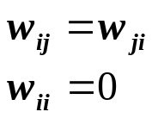
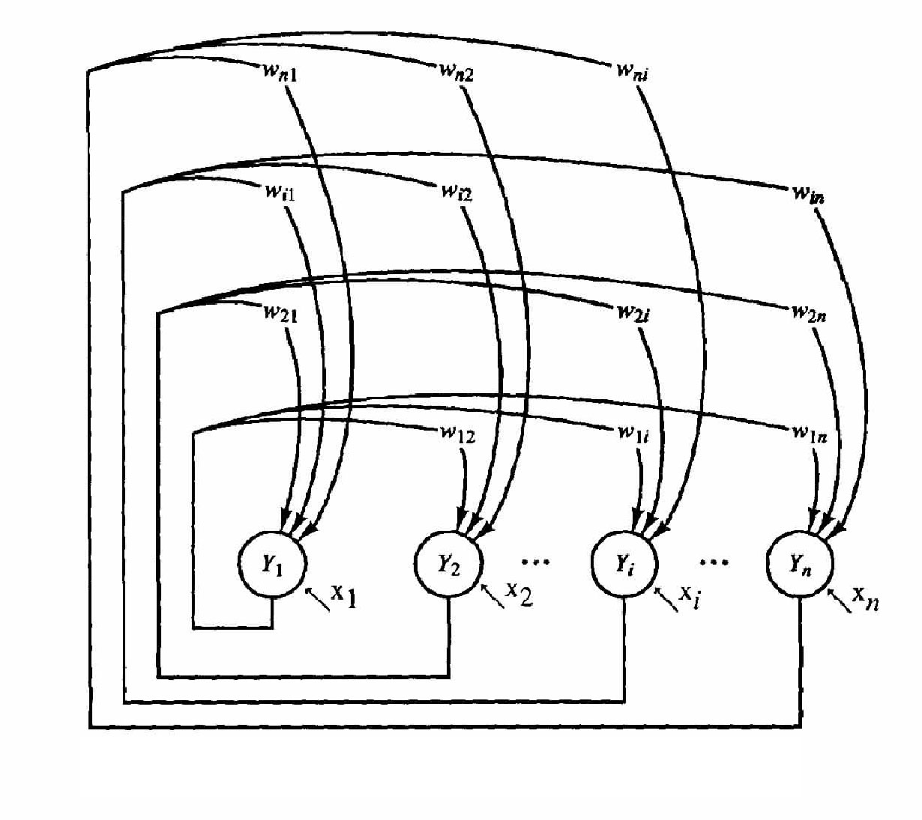
ARCHITECTURE OF DHN
Architecture
  Single-layer (units serve as both input and output):
  nodes are threshold units (binary or bipolar).
  weights: fully connected, symmetric, and zero diagonal.
  x_{i} are external inputs, which may be transient or permanent.
“Principles of Soft Computing, 2nd Edition”
by S.N. Sivanandam & SN Deepa
Copyright © 2011 Wiley India Pvt. Ltd. All rights reserved.

Slide 19
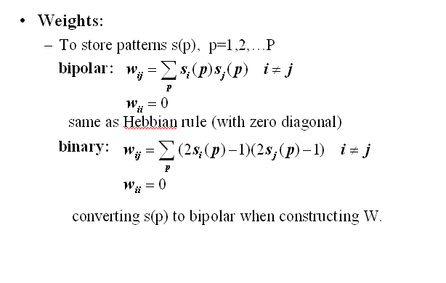
“Principles of Soft Computing, 2nd Edition”
by S.N. Sivanandam & SN Deepa
Copyright © 2011 Wiley India Pvt. Ltd. All rights reserved.

Slide 20
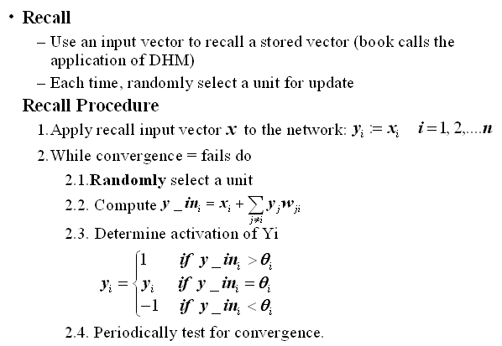
“Principles of Soft Computing, 2nd Edition”
by S.N. Sivanandam & SN Deepa
Copyright © 2011 Wiley India Pvt. Ltd. All rights reserved.

Slide 21
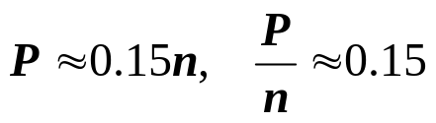
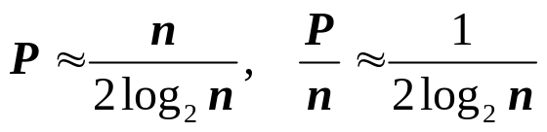
STORAGE CAPACITY OF DHN
P: maximum number of random patterns of dimension n can be stored in a DHM of n nodes
Hopfield’s observation:
Theoretical analysis:
  P/n decreases because larger n leads to more interference between stored patterns.
Some work to modify HM to increase its capacity to close to n, W is trained (not computed by Hebbian rule).
“Principles of Soft Computing, 2nd Edition”
by S.N. Sivanandam & SN Deepa
Copyright © 2011 Wiley India Pvt. Ltd. All rights reserved.

Slide 22

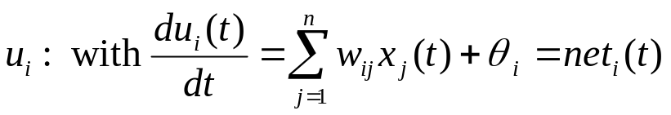

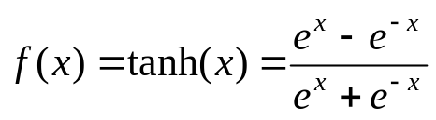
CONTINUOUS HOPFIELD NET
Architecture
  Continuous node output, and continuous time
  Fully connected with symmetric weights
  Internal activation
  Output (state)
  where f is a sigmoid function to ensure binary/bipolar output. E.g. for bipolar, use hyperbolic tangent function:
“Principles of Soft Computing, 2nd Edition”
by S.N. Sivanandam & SN Deepa
Copyright © 2011 Wiley India Pvt. Ltd. All rights reserved.

Slide 23
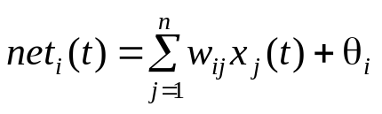

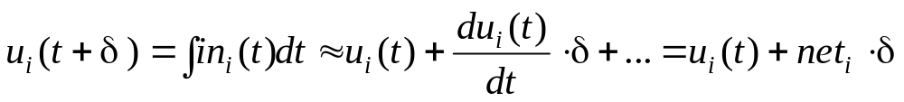
CONTINUOUS HOPFIELD NET
Computation: all units change their output (states) at the same time, based on states of all others.
  Compute net:
  Compute internal activation by first-order Taylor expansion
  Compute output
“Principles of Soft Computing, 2nd Edition”
by S.N. Sivanandam & SN Deepa
Copyright © 2011 Wiley India Pvt. Ltd. All rights reserved.

Slide 24
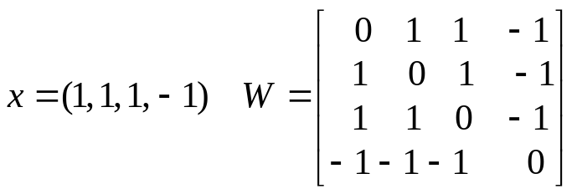
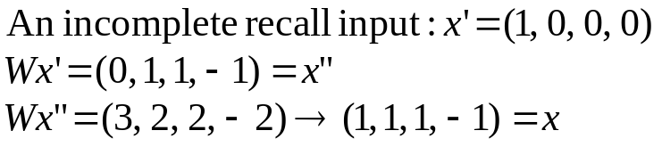
ITERATIVE ASSOCIATIVE MEMORY NETWORK
Example
In general: using current output as input of the next iteration
  x(0) = initial recall input
  x(I) = S(Wx(I-1)), I = 1, 2, ……
  until x(N) = x(K) for some K < N
Output units are threshold units
“Principles of Soft Computing, 2nd Edition”
by S.N. Sivanandam & SN Deepa
Copyright © 2011 Wiley India Pvt. Ltd. All rights reserved.

Slide 25
Dynamic System: State vector x(I)
If K = N-1, x(N) is a stable state (fixed point)
f(Wx(N)) = f(Wx(N-1)) = x(N)
  If x(K) is one of the stored pattern, then x(K) is called a genuine memory
    Otherwise, x(K) is a spurious memory (caused by cross-talk/interference between genuine memories)
    Each fixed point (genuine or spurious memory) is an attractor (with different attraction basin)
“Principles of Soft Computing, 2nd Edition”
by S.N. Sivanandam & SN Deepa
Copyright © 2011 Wiley India Pvt. Ltd. All rights reserved.

Slide 26
  If K != N-1, limit-circle,
    The network will repeat
    x(K), x(K+1), …, x(N) = x(K) when iteration continues.
    Iteration will eventually stop because the total number of distinct state is finite (3^n) if threshold units are used. If patterns are continuous, the system may continue evolve forever (chaos) if no such K exists.
“Principles of Soft Computing, 2nd Edition”
by S.N. Sivanandam & SN Deepa
Copyright © 2011 Wiley India Pvt. Ltd. All rights reserved.

Slide 27
SUMMARY
This chapter discussed on the various associative networks:
Autoassociative Network
Hetero-associative Network
Bidirectional Associative Memory Network
Hopfield Nets
Iterative Associative Nets
“Principles of Soft Computing, 2nd Edition”
by S.N. Sivanandam & SN Deepa
Copyright © 2011 Wiley India Pvt. Ltd. All rights reserved.

